Slide 1

Windows Server 2019 Installation

Slide 2

Installation Demo
Prerequisites for Installation of Windows Server 2019 on your System
“Latest Version of Virtualbox should be installed on your System”

Slide 3
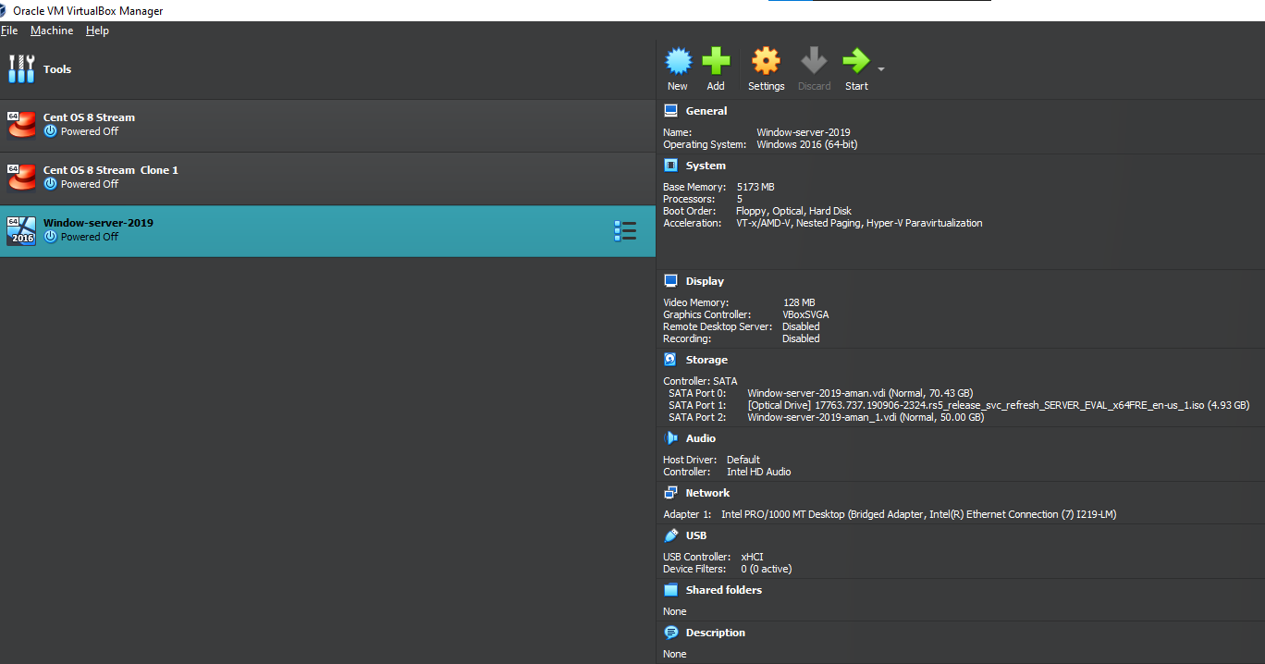
This is how the Interface of Virtual Box Looks

Slide 4
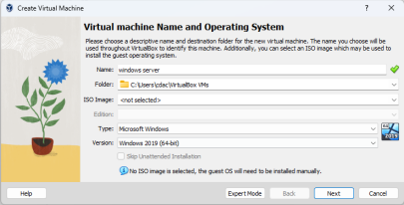
Step 1-
Create Virtual machine and Add Virtual Disk

Slide 5
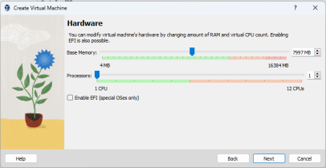
Step 2
Give Hardware base memory and processors.

Slide 6
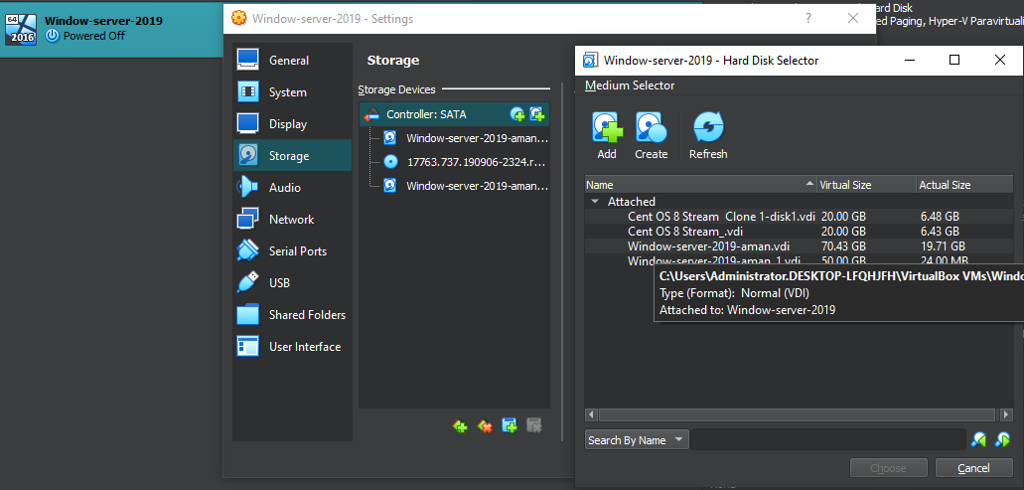
STEP 3
Create Virtual hard disk.

Slide 7
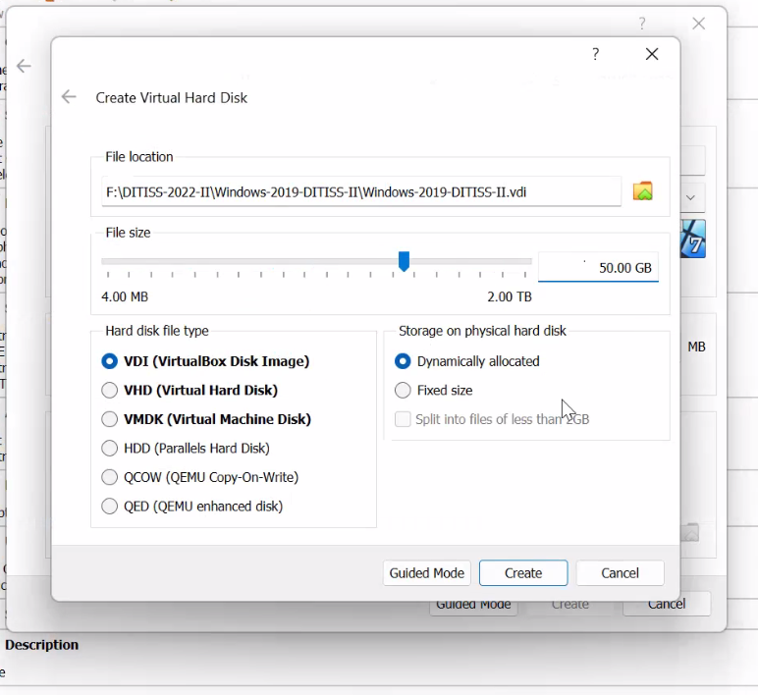
Create virtual hard disk —-> select VDI —--> Select dynamic allocate

Slide 8
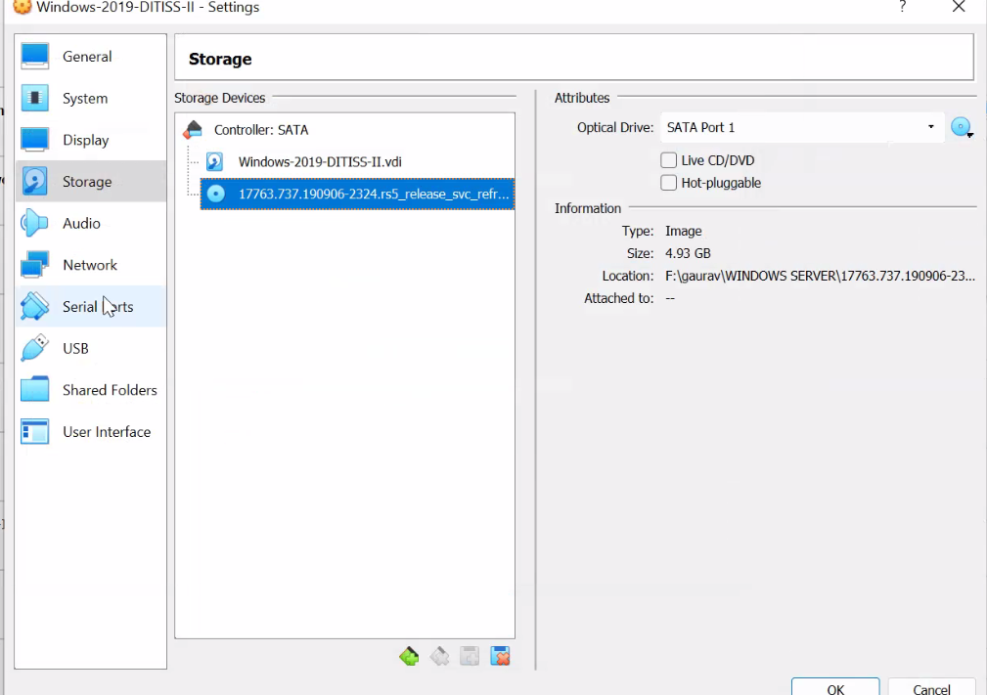
Step 4 :
Go to storage on Select SATA option
Add ISO Image Windows Server 2019

Slide 9
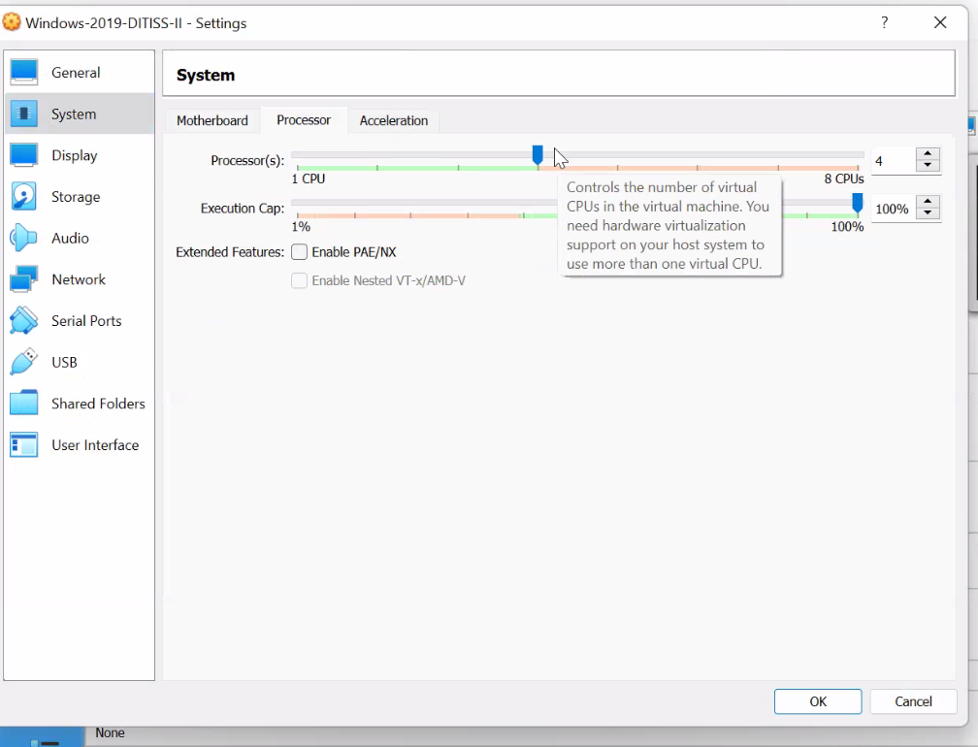
Step 5
Give Virtual Machine Configuration

Slide 10
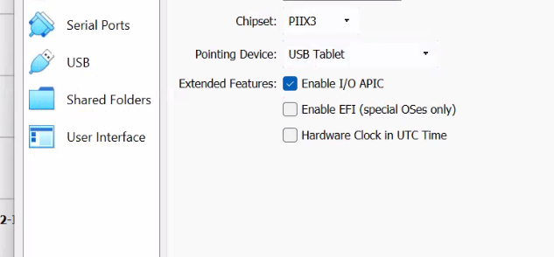
Step 6
In USB Settings Select Pointing Device as USB TABLET

Slide 11
“THESE ALL WERE PREREQUISITE
CONFIGURATION
AND
SETTINGS WHICH WE HAVE TO DO”

Slide 12
“AFTER SETTING UP ALL THE
CONFIGURATION BY FOLLOWING THE PREREQUISITE PROCESS, INSTALLATION
OF WINDOWS SERVER 2019 STARTS”

Slide 13
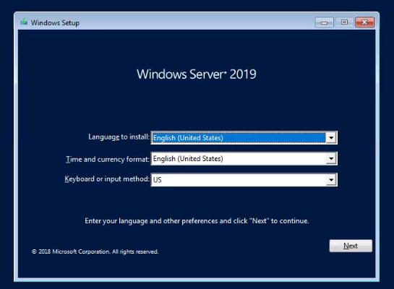
INSTALLATION OF WINDOWS SERVER 2019 STARTS
FOLLOW THE PROCESS OF INSTALLATION

Slide 14
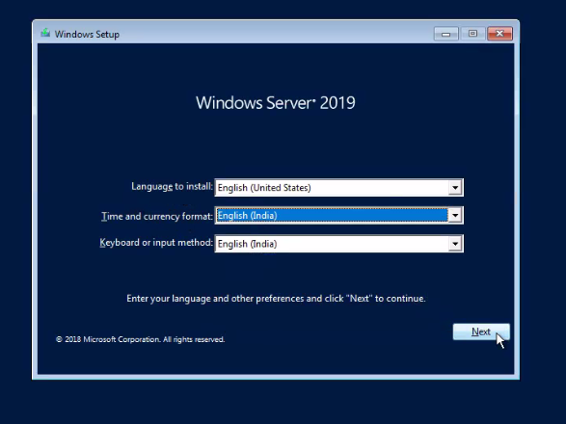
Step 1
Select the Language & Keyboard to English INDIA

Slide 15
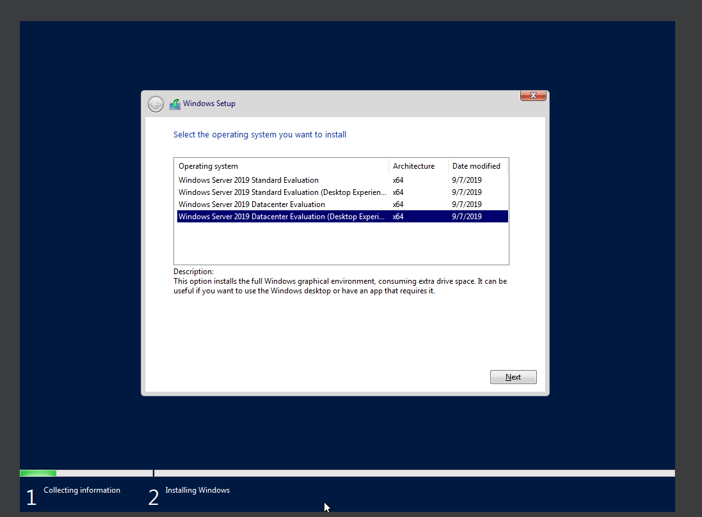
Step 2
Select Windows Server 2019 Datacenter Evaluation(Desktop Experience)

Slide 16
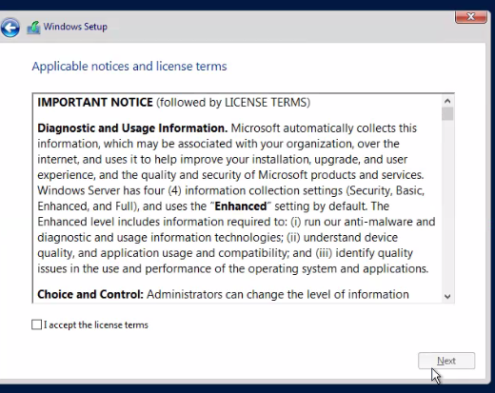
Step 3
Accept the license terms.

Slide 17
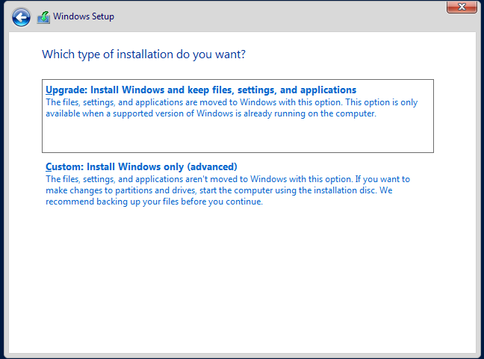
Step 4
Select Custom Install

Slide 18
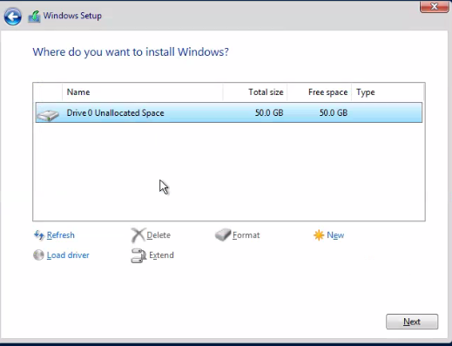
Step 5
Create a New Partition for Space Allocation of Windows Server 2019

Slide 19
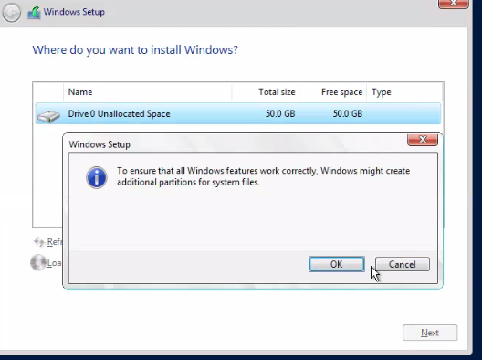
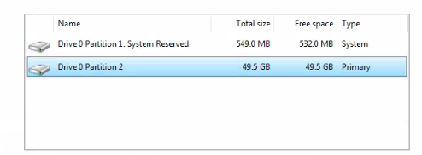
This will pop up will showup and after selecting ok
Disk Partition will be Created

Slide 20
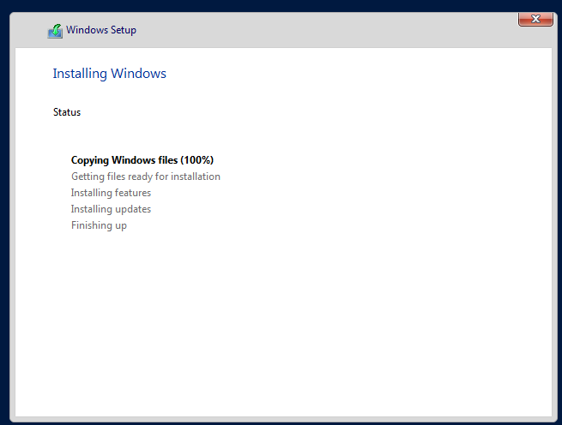
Step 6
Installing Windows Begins

Slide 21
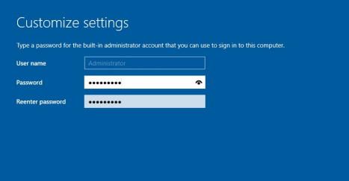
Step 7
Now After Installation Set admin password like ‘Welcome@123’

Slide 22
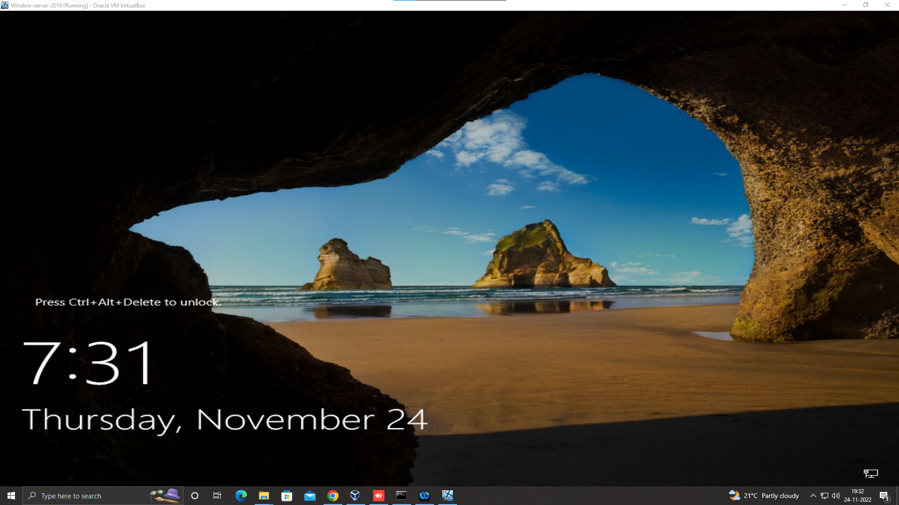
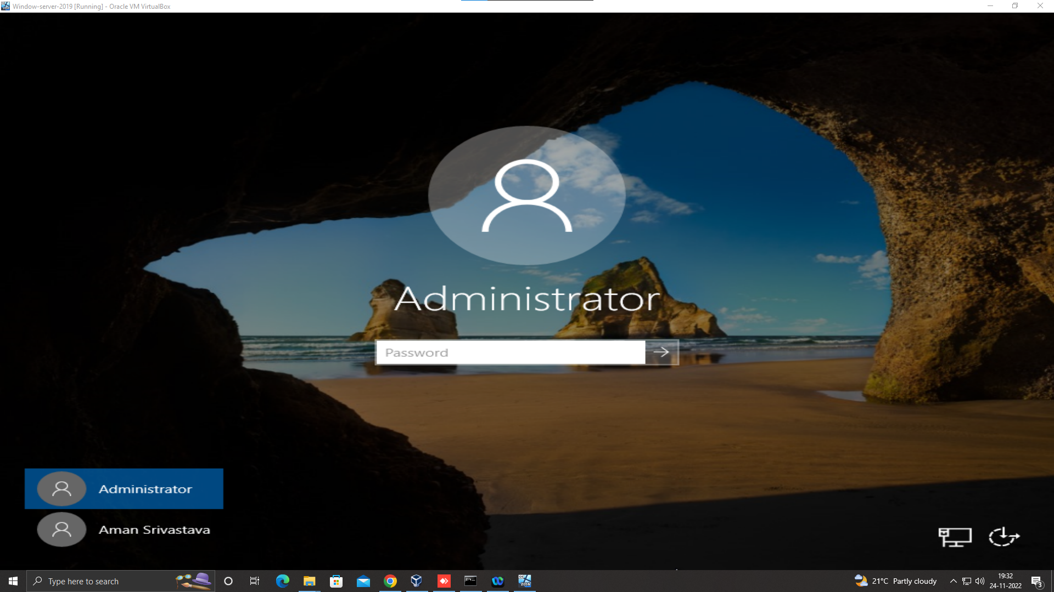
Your Windows Server 2019 is Ready To Use

